Slide 1
IPA POOL

Slide 2
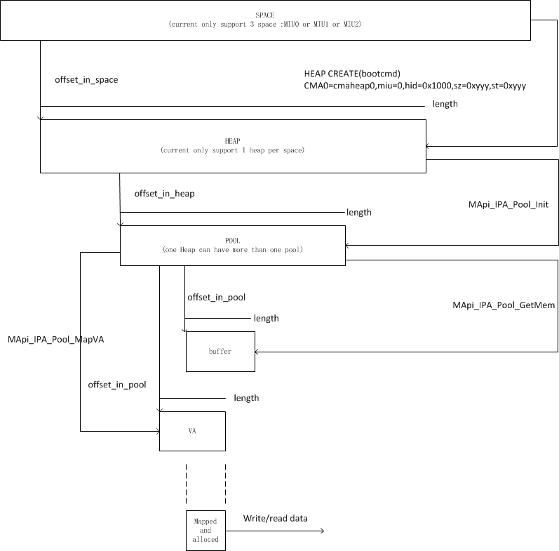

Slide 3
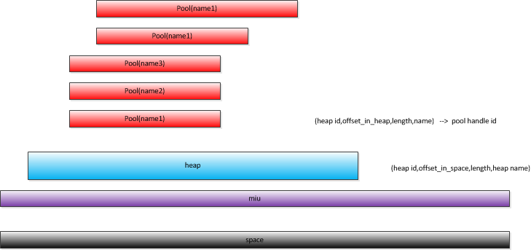
Relation about space/heap/pool

Slide 4
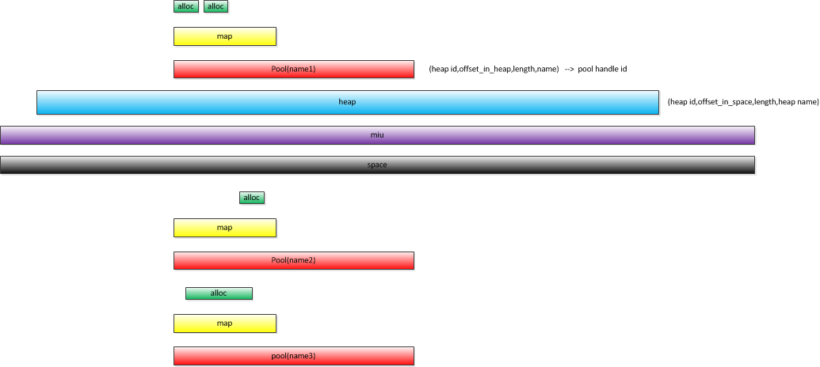
//THEALE/RedLion_develop/3.10.40_Messi_CMA2/mstar2/drv/ipa_pool/IPA_Pool_test_code/IPA_Pool_test_code_example/IPA_Pool_test_code.c
test_case_6

